Slide 1
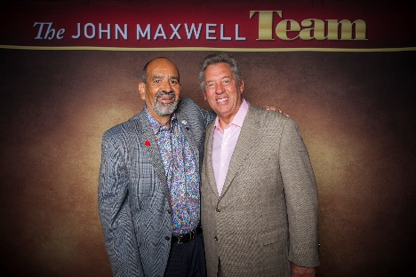
Welcome Bienvenidos
Memo Vargas

Slide 2
A DREAM is a picture and blueprint
of a person’s Purpose and Potential
Notes:
A dream can be put to the test and pass. A dream is an inspiring picture of the future that energizes your mind, will and emotions. Empowering you to do everything you can to achieve it.

Slide 3
4 Common Reasons for not identifying dreams
Disappointment
Discouragement
Settling
Lack of Confidence
Notes:
4 common reasons people have for not identifying their dream:
Discouragement from dreaming by others
Hindrance by past disappointments and hurts – disappointment is the gap between expectation and reality
Habit of settling for average
Lack of confidence needed to pursue dreams

Slide 4
Survey of highly successful leaders
Have a dream
Given up on a dream
Accomplished dream
Frustrated at times in pursuit of dream

Slide 5
Dream Test
Pathway
People
Passion
Cost
Reality
Tenacity
Clarity
Fulfillment
Ownership
Significance
Notes:
Ownership – is my dream really my dream
Clarity – do I clearly see my dream
Reality – am I depending on factors in my control to achieve my dream
Passion – does my dream compel me to follow it
Pathway – do I have a strategy to reach my dream
People – have I included the people I need to realize my dream
Cost – am I willing to pay the price for my dream
Tenacity – am I moving closer to my dream
Fulfillment – does working toward my dream bring satisfaction
Significance – does my dream benefit others

Slide 6
#1 Ownership
Someone else owns your dream
It will not have the right fit
It will be a weight on your shoulders
It will drain your energy
It will put you to sleep
It will take you out of your strength zone
It will be fulfilling to others
It will require others to make you do it
You own your dream
It will feel right to you
It will provide you wings to your spirit
It will fire you up
It will keep you up at night
It will take you out of your comfort zone
It will be fulfilling to you
You will feel you were made to do it

Slide 7
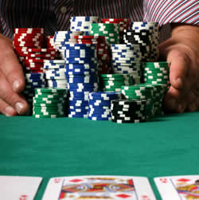
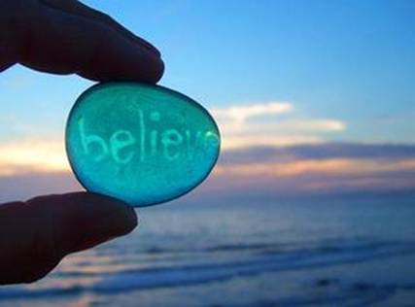
Taking Ownership
Bet on yourself
Love what you do
Lead your life
Don’t compare
Believe in your vision
Notes:
How to take ownership of your dream
Be willing to bet on yourself
Lead your life instead of accepting your life – making the right decisions and managing those decisions daily
Love what you do and do what you love
Don’t compare yourself or your dream to others – when you compare yourself with those superior, you feel inferior. When you compare yourself with those inferior, you feel superior. When you stop comparing yourself with others, you feel empowered.
Believe in your vision for the future even when others don’t understand you

Slide 8
#2 Clarity
feeling
sensing
PURPOSE AFFIRMED!!!
seeing
hearing
thinking
PRIORITIES DETERMINED!!!
Notes:
Clarity
A clear dream makes a general idea very specific
A clear dream doesn’t become clear without effort – what am I feeling, sensing, seeing, hearing, thinking…
A clear dream affirms your purpose
A clear dream determines your priorities

Slide 9
Fantasizers v. Dream Builders
Rely on luck
Focus on the destination
Cultivate unhealthy expectations
Minimize the value of work
Look for excuses
Create inertia
Breed isolation
Wait
Avoid personal risk
Make others responsible
Rely on discipline
Focus on the journey
Cultivate healthy discontent
Maximize the work they do
Lead to action
Generate momentum
Promote teamwork
Initiate
Embrace risk as necessary
Make themselves responsible

Slide 10
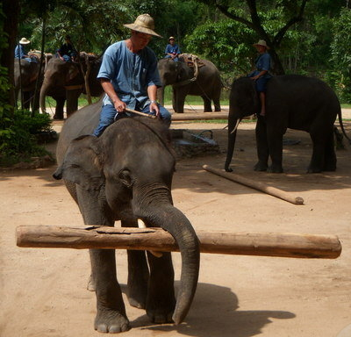
#3 Reality
Law of Least Effort
Consistent good results
Maximum Effort + Maximum Strength = Maximum Return
Notes:
The more unrealistic your dream, the more you will be tempted to depend upon things you cannot control to make it become a reality.
Adding realism to your dream
Building on your strengths activates the law of least effort
Building on your strengths enables consistent good results

Slide 11
Reality Roadmap
START AT A CERTAIN PLACE
DETERMINE WHAT YOU
NATURALLY DO WELL
INJECT HABITS
REALIZE POTENTIAL
REALIZE DREAM
Reality is the foundation of your dream

Slide 12
#4 Passion
Gives initiative
Overcomes adversity
Increases odds for success
Notes:
Passion pulls us up – enabling us to overcome adversity
Passion pulls us out – giving us initiative
Passion positions us well – giving us the greatest odds for success

Slide 13
#5 Pathway
SECURE
State all of your positions
Examine all of your actions
Consider all of your options
Utilize all of your resources
Remove all nonessentials
Embrace all of our challenges

Slide 14
#6 People
My dream team includes people:
who inspire me,
who are honest with me,
and who’s skills compliment mine

Slide 15
How to make your dream their dream
Emotionally
Logically
Visually
Notes:
Leader births dream and then finds people
Followers find the leader and then find the dream
Dreams must be transferred
Logically – by communicating a realistic understanding of the present situation and by providing a sound strategy
Emotionally
Visually – show them the dream from their perspective and show them your heart – you need to let people see your heart and your hope

Slide 16
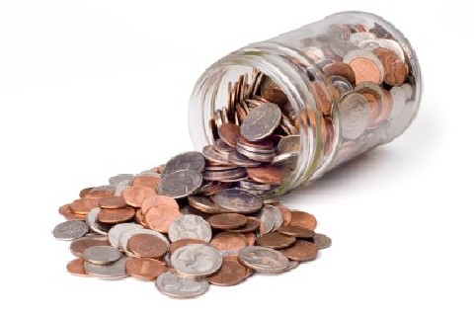
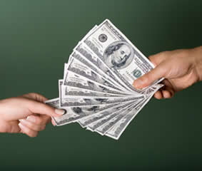
#7 Cost
The dream is free, but the journey isn’t
The price must be paid sooner than you think
The price will be higher than you expect
The price must be paid more than once
It is possible to pay too much for your dream

Slide 17
#8 Tenacity
Dream
Moving forward when everything isn’t perfect
Improve vocabulary
Resources stop the moment you stop
The Rule of Five
When you have exhausted all possibilities – you haven’t
Notes:
To move closer to your dream:
Recognize that quitting is more about who you are than where you are.
Improve your vocabulary
Recognize that waiting for everything to be right is wrong
Change your thinking
Recognize that the resources for your dream stop the moment you do
Practice the Rule of Five
Remember that when you have exhausted all possibilities – you haven’t

Slide 18
#9 Fulfillment
Realization
Dream
Size of Dream = Size of Gap
New discoveries are made
Natural Law
of Balance
Appreciation for every step of the journey

Slide 19
#10 Significance
For myself
For others
With others

Slide 20
Dare to Dream
Prepare the Dream
Wear the Dream
Repair the Dream
Share the Dream

Slide 21
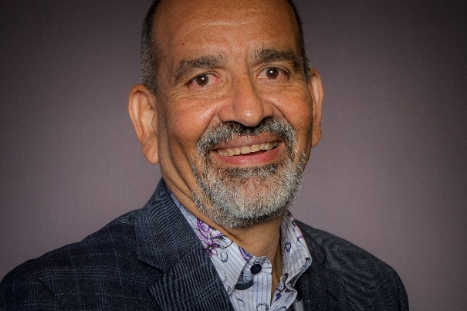
Thank You Gracias
Memo Vargas

